Slide 1
Cover's theorem on separability of patterns

Slide 2
What is Cover’s Theorem
The Cover’s Theorem gives a detailed description of the separability of patterns. This theorem explains how a radial basis function network can perform a complex pattern classification task. Considering the Cover’s Theorem, Haykin declares that a radial basis function network performs a complex pattern-classification task by transforming the problem into a high-dimensional space in a nonlinear manner.

Slide 3
Cover’s Theorem on separability of Patterns
A complex pattern-classification problem , cast in a high-dimensional spacenonlineary, is more likely to be linearly separable than in a low-dimensional space, provided that the space is not densely populated.

Slide 4
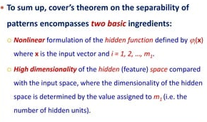

Slide 5
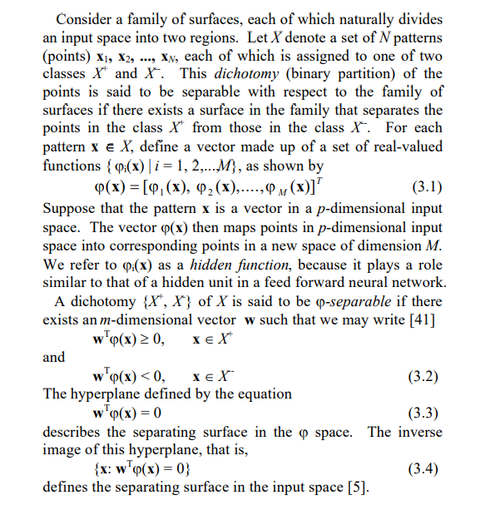
He gives a detailed definition of Cover’s Theorem as follows:

Slide 6
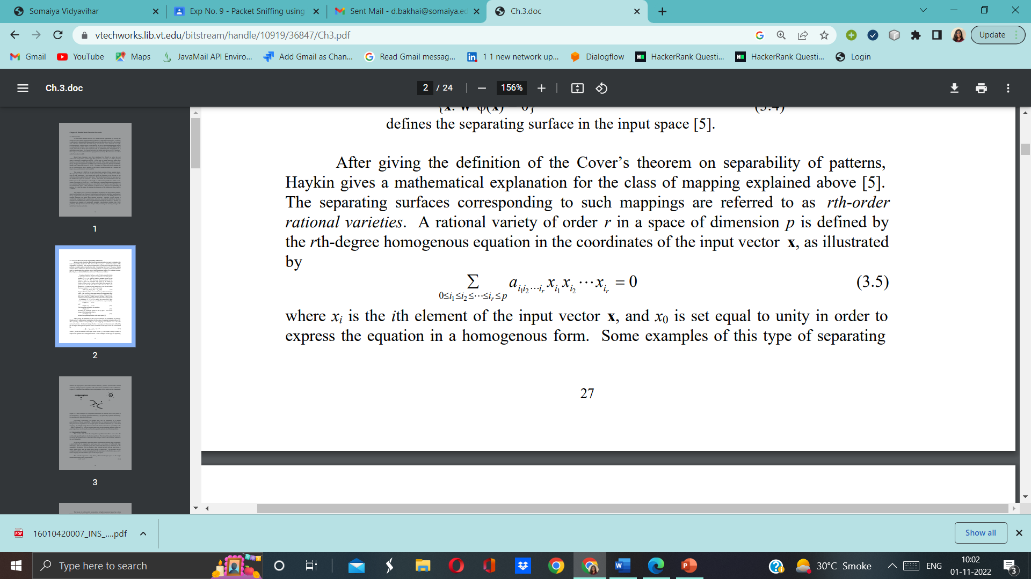
mathematical explanation for the class of mapping explained above:
The separating surfaces corresponding to such mappings are referred to as rth-order rational varieties. A rational variety of order r in a space of dimension p is defined by the rth-degree homogenous equation in the coordinates of the input vector x, as illustrated by
where xi is the ith element of the input vector x, and x0 is set equal to unity in order to express the equation in a homogenous form.

Slide 7
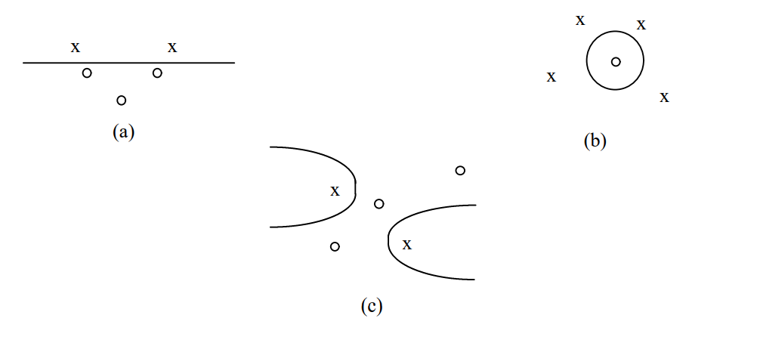
Some examples of this type of separating 28 surfaces are hyperplanes (first-order rational varieties), quadrics (second-order rational varieties), and hyperspheres (quadrics with certain linear constraints on the coefficients).
Three examples of j-separable dichotomies of different sets of five points in two dimensions: (a) linearly separable dichotomy; (b) spherically separable dichotomy; (c) quadratically separable dichotomy.

Slide 8
Polynomial separability, as defined here, can be considered as a natural generalization of linear separability. Haykin provides an important point, which states that given a set of patterns x in an input space of random dimension p, a non-linear mapping (x) of high enough dimension M can be found so that linear separability in the space is obtained

Slide 9
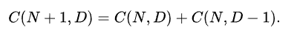
Proof
The proof of Cover's counting function theorem can be obtained from the recursive relation.
To show that, with fixed {\displaystyle N}N, increasing {\displaystyle D}D may turn a set of points from non-separable to separable, a deterministic mapping may be used: suppose there are {\displaystyle N}N points. Lift them onto the vertices of the simplex in the {\displaystyle N-1}N-1 dimensional real space. Since every partition of the samples into two sets is separable by a linear separator, the property follows.

Slide 10


